Slide 1
Computer Networks Wireless Channel Modeling
Amitangshu Pal
Computer Science and Engineering
IIT Kanpur

Slide 2
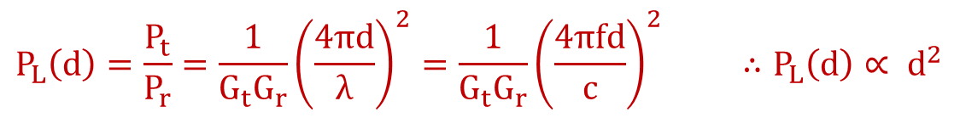


Path Loss
Free space path loss:
Signal goes through
Reflections
Scattering
Diffractions
Attenuation due to obstructions
In general:
$$P_{L}\left(d\right)=\frac{P_{t}}{P_{r}}={\frac{1}{G_{t}G_{r}}\left(\frac{4πd}{λ}\right)}^{2}={\frac{1}{G_{t}G_{r}}\left(\frac{4πfd}{c}\right)}^{2} ∴P_{L}\left(d\right)∝ d^{2}$$
$$P_{L}\left(d\right)∝d^{n} 2≤n≤8$$
$n$ → Path loss exponent

Slide 3
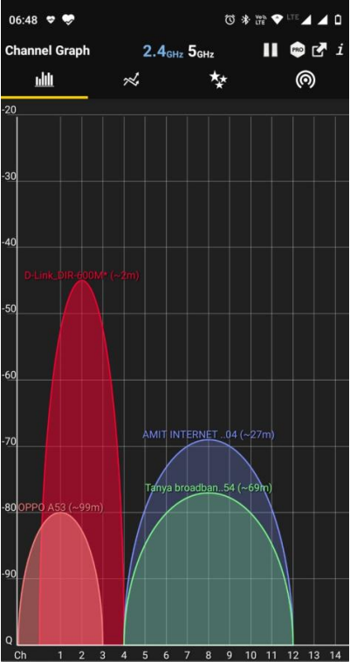
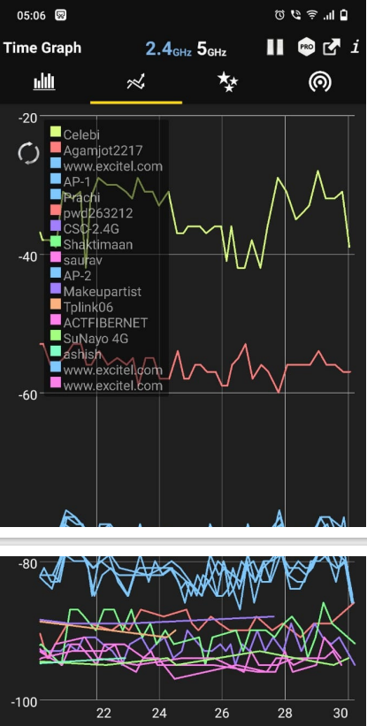
Path Loss
Data from Wifi Analyzer: https://play.google.com/store/apps/details?id=com.farproc.wifi.analyzer&hl=en_IN&gl=US

Slide 4

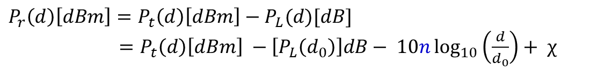
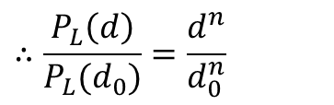
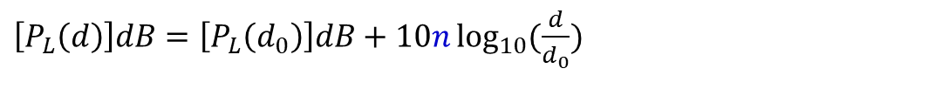
Combined Path Loss and Shadowing
$$∴\frac{P_{L}\left(d\right)}{P_{L}(d_{0})}=\frac{d^{n}}{d_{0}^{n}}$$
$$P_{L}\left(d\right)∝d^{n}$$
10n
P_{L}(dB)
$\left[P_{L}\left(d\right)\right]dB=\left[P_{L}\left(d_{0}\right)\right]dB+10n\log_{10}{(\frac{d}{d_{0}})}$
log(d)
$\left[P_{L}\left(d\right)\right]dB=\left[P_{L}\left(d_{0}\right)\right]dB+10n\log_{10}\left(\frac{d}{d_{0}}\right)+ χ; χ= ℕ(0, σ^{2})$
$$P_{r}\left(d\right)\left[dBm\right]=P_{t}\left(d\right)\left[dBm\right]−P_{L}(d)[dB]$$
$=P_{t}\left(d\right)\left[dBm\right] −\left[P_{L}\left(d_{0}\right)\right]dB− 10n\log_{10}\left(\frac{d}{d_{0}}\right)+ χ$
-10n
P_{r}(dB)
Log Normal Shadowing Model
log(d)

Slide 5
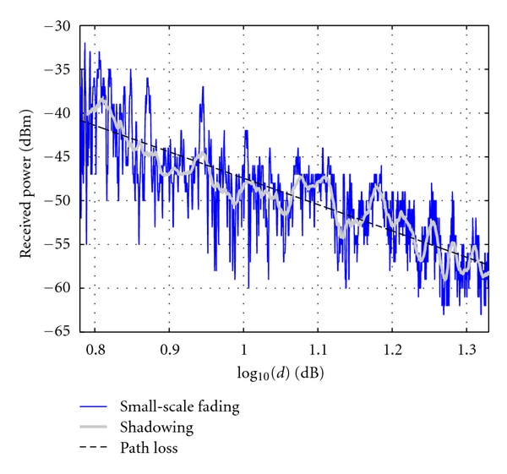
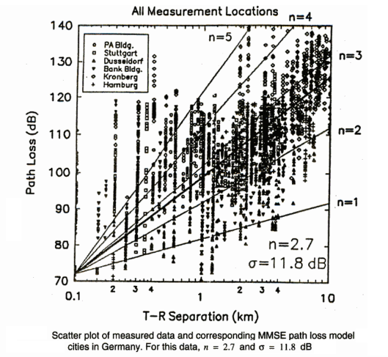
Some Real Data
Src: https://www.hindawi.com/journals/jr/2011/340372/fig6/
Src: Wireless Communications by Theodore S. Rappaport

Slide 6
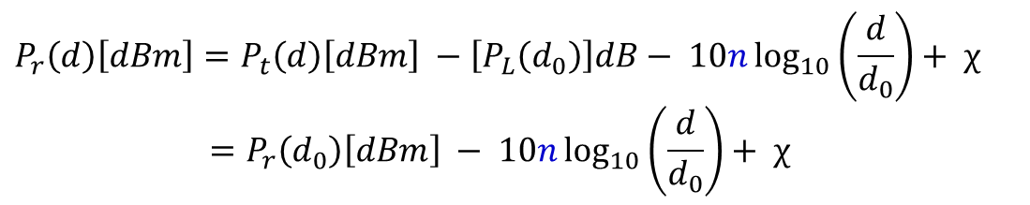
How to Measure n?
Measuring n:
Draw the “Best fit” line through dB data
Find the slope → divide by 10
Shadowing variance:
Variance of data relative to the best fit straight line
$$P_{r}\left(d\right)\left[dBm\right]=P_{t}\left(d\right)\left[dBm\right] −\left[P_{L}\left(d_{0}\right)\right]dB− 10n\log_{10}\left(\frac{d}{d_{0}}\right)+ χ$$
$$=P_{r}\left(d_{0}\right)\left[dBm\right] − 10n\log_{10}\left(\frac{d}{d_{0}}\right)+ χ$$
-10n
P_{r}(dB)
log(d)

Slide 7
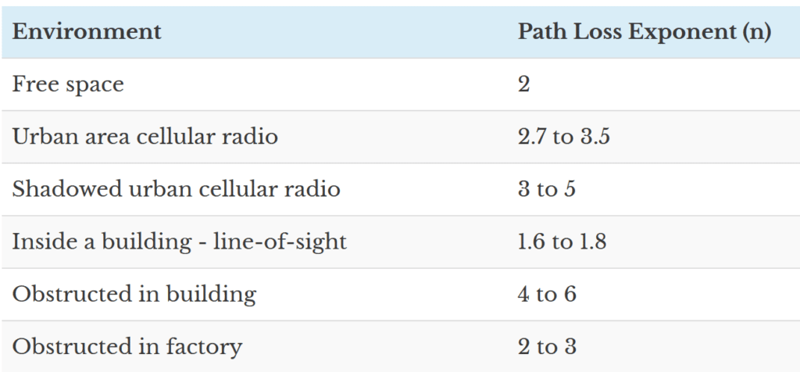
Typical Values for Path loss exponent
Src: https://www.gaussianwaves.com/2013/09/log-distance-path-loss-or-log-normal-shadowing-model/

Slide 8
Multipath Propagation

Slide 9
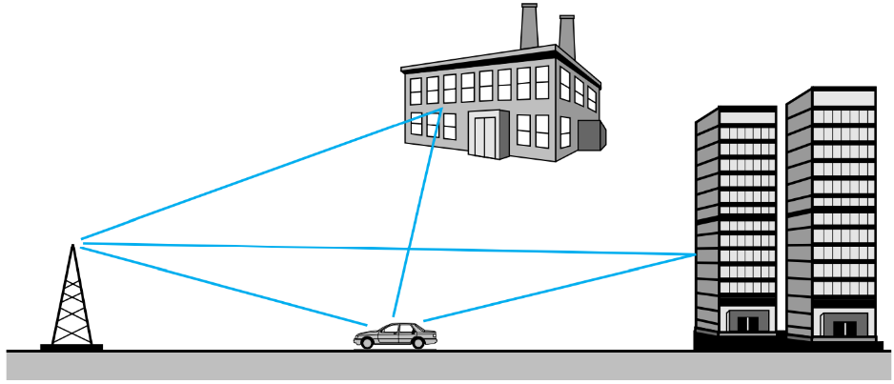
Multipath Propagation
Multiple signal components reach at the receiver
Each component experiences different levels of attenuation and delay
Leads to time-varying channel impulse response

Slide 10
Multipath Propagation
Amplitude
Time
Channel Impulse Response

Slide 11
Multipath Propagation
Amplitude
Time
Channel Impulse Response

Slide 12
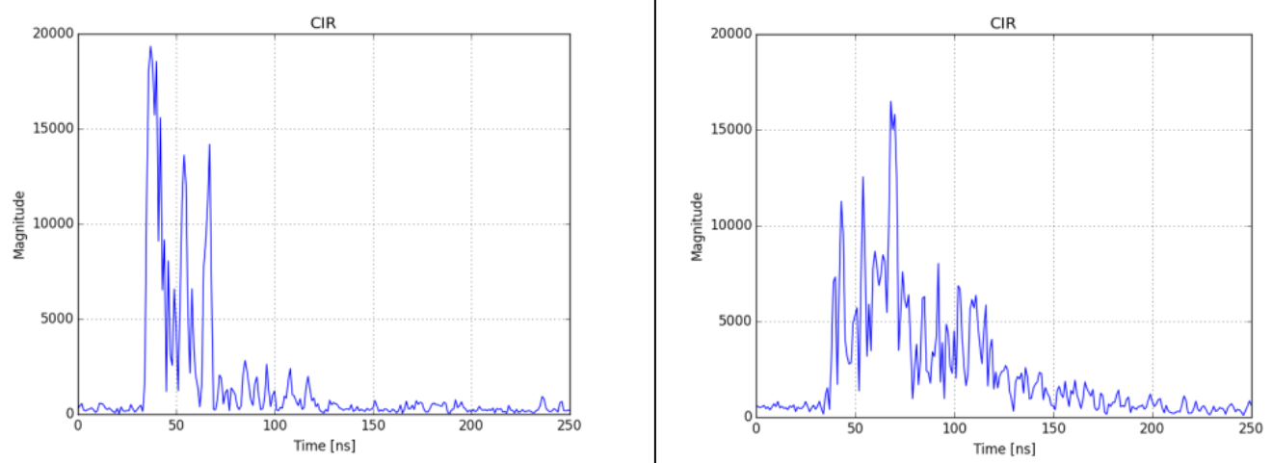
Multipath Propagation
Src: Bregar, Klemen & Hrovat, Andrej & Mohorcic, Mihael. (2016). NLOS Channel Detection with Multilayer Perceptron in Low-Rate Personal Area Networks for Indoor Localization Accuracy Improvement.

Slide 13
Summary
Wireless channel modeling:
Free space path loss
Log normal shadowing model
Path loss exponent
Multipath propagation

